Slide 1
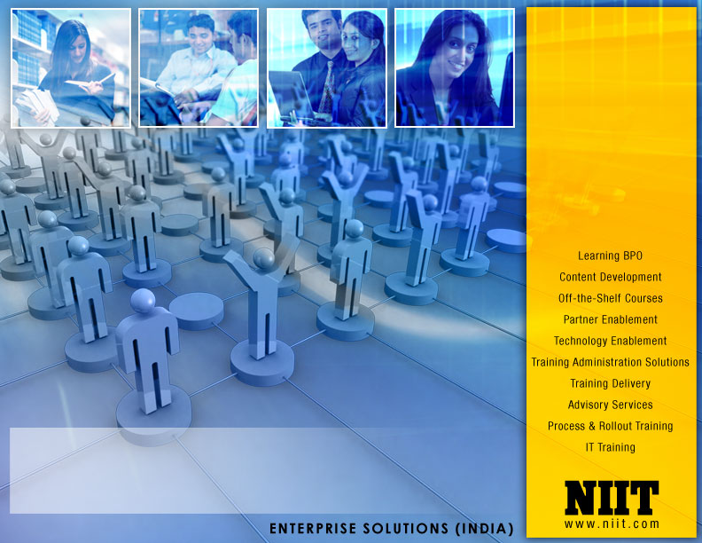
Deloitte Pre Hire Training 2017
FOUNDATION TRAINING
Spring MVC

Slide 2
Spring 3 MVC
View Resolvers

Slide 3
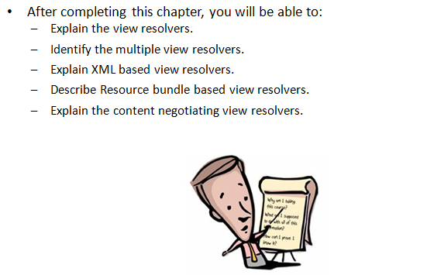
Objectives

Slide 4
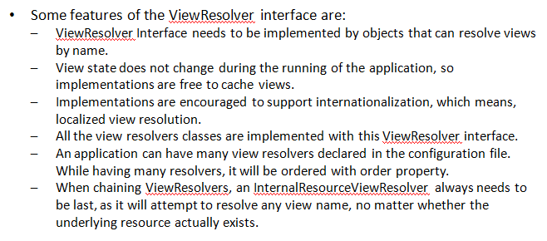
View Resolver Interface

Slide 5
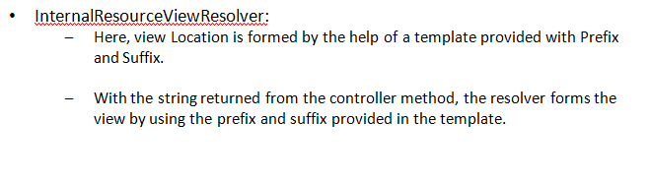
InternalResourceViewResolver

Slide 6
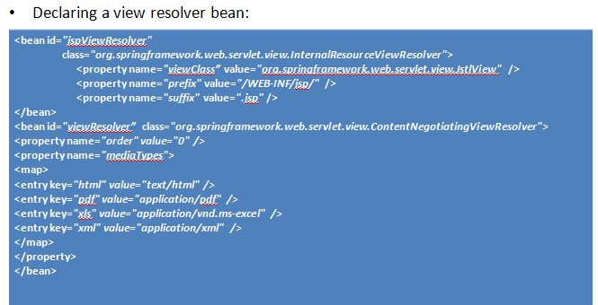
Configuring a View Resolver

Slide 7
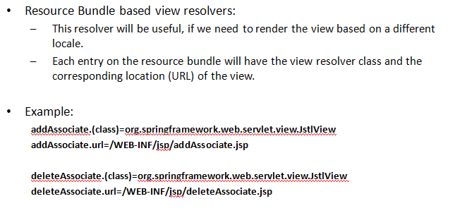
View Resolver: Resource Bundle

Slide 8
Demo
Code to explain the View Resolver configuration and execution.

Slide 9
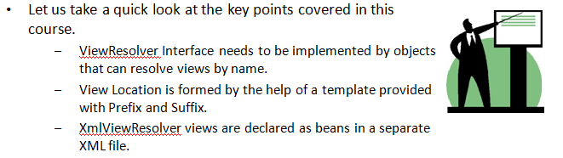
Summary

